Slide 1
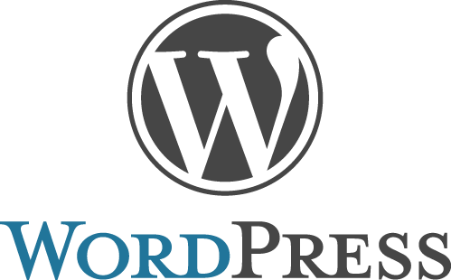
WORDPRESS
WTL active learning group 1
Panel E
PE 01 Ayush Gour
PE 02 Aniket Ghorpade
PE 03 Vishwajeet shinde
PE 04 Aniruddha Shende
PE 05 Yash Bhargava
PE 06 Hrishikesh vaze
PE 07 Nimish Agarwal
PE 08 Adnan Shoaib Nazmuddin

Slide 2
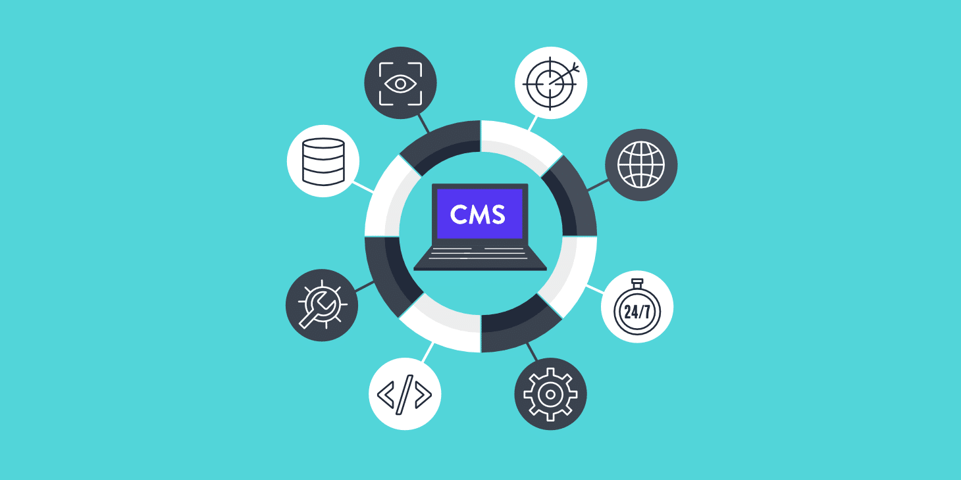
Introduction to CMS
A content management system is made up of two core parts:
●A content management application (CMA) – this is the part that allows you to actually add and manage content on your site.
●A content delivery application (CDA) – this is the backend, behind-the-scenes process that takes the content you input in the CMA, stores it properly, and makes it visible to your visitors.
●A content management system, often abbreviated as CMS, is software that helps users create, manage, and modify content on a website without the need for specialized technical knowledge.
●In CMS, we can write our content to be displayed, in an interface that looks a good bit like Microsoft Word.
Also to manage media like images and video, instead of interacting with web server and logging into backend, it can be done directly through media library provided by CMS

Slide 3
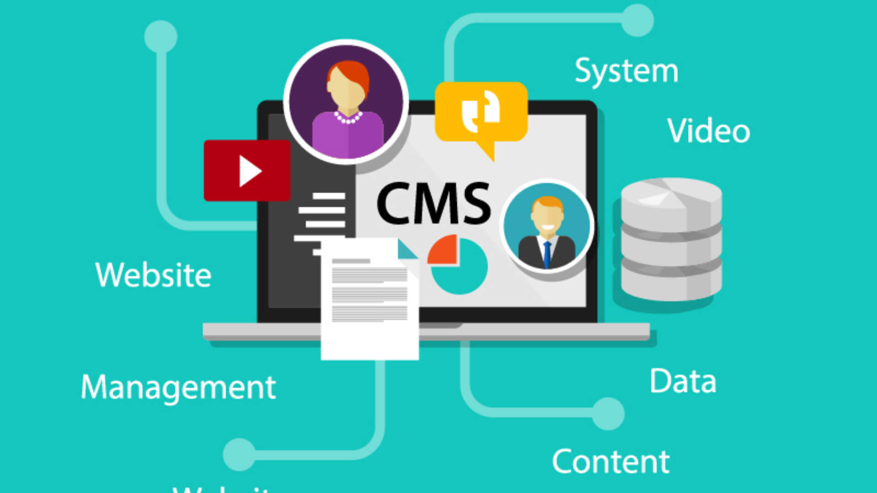
Key Features:
●Content management: How, and how easily, can you create, edit, post, and manage web content (including text, images, video, and audio)
●Presentation: Customers jump from device to device, and no marketing org can put human effort into optimizing every blog post or catalog page for laptop, tablet, and top smart phone formats.
●Integration: Is the solution holistic , like Sitecore’s Experience Platform, or does it rely on APIs to connect your content to other applications.
●Commerce: A crucial integration is being able to connect a personalized marketing presentation to your digital commerce systems. You can’t address the “customer journey” if you leave this destination off your map.
●Personalization: Can it target relevant content to unique visitors, by persona, location, or even individually based on past interaction with your brand?

Slide 4
●Analytics: You’re serving up content, but is anyone reading it? And what do they do next? Demand visibility into performance so you can optimize your efforts and define ROI.
●Governance: Can you find stuff after you post it? Can you strictly control who’s allowed to approve it, change it, publish it, take it down? Can you tell when content has aged out of usefulness?
●Multilingual support: Are you translating into other languages and publishing globally? Can the solution support that?
●Scalability/Performance/Stability: Is the solution reliable from a fundamental technology standpoint, and will it grow with your organization’s needs?
●Training/vendor support: CMS solutions are increasingly complex, with ever-greater promises, but most teams need help to get up and running beyond a basic level.

Slide 5
Wordpress
●WordPress quickly grew to be an extensive CMS able to handle a variety of websites from blogging to e-commerce to business and portfolio websites.
●Designed with usability and flexibility in mind, WordPress is a great solution for both large and small websites.
●WordPress is a free, open-source website creation platform. It is a content management system (CMS) written in PHP that uses a MySQL/MariaDB database.
●WordPress was released on May 27, 2003, by its founders, American developer Matt Mullenweg and English developer Mike Little.

Slide 6
Features
●Media file library: WordPress includes a built-in media library where you can upload and embed media files such as images or videos into your pages or posts.
●Easy-to-use user interface: WordPress is very easy to use with no complicated settings. WordPress also has a focus on accessibility.
●Custom menus: WordPress makes it easy to create navigation menus with links to your pages or custom links.
●Built-in blog: Adding a blog to your website is as simple as publishing a post.
●Speed: WordPress is a lean website framework that is constantly striving to remove code “bloat” that slows down the loading speed of a website.
●Mobile-friendly: Most WordPress themes are now mobile-friendly or responsive out-of-the-box.

Slide 7
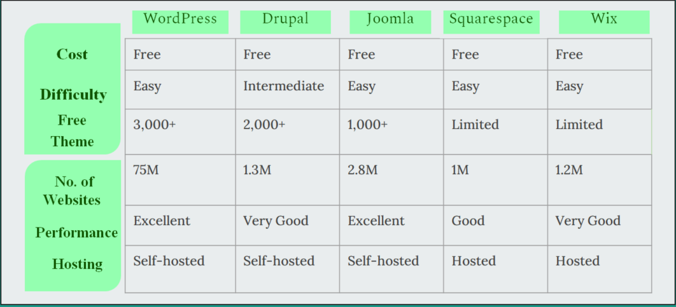
COMPARISON AMONG CMS’s

Slide 8
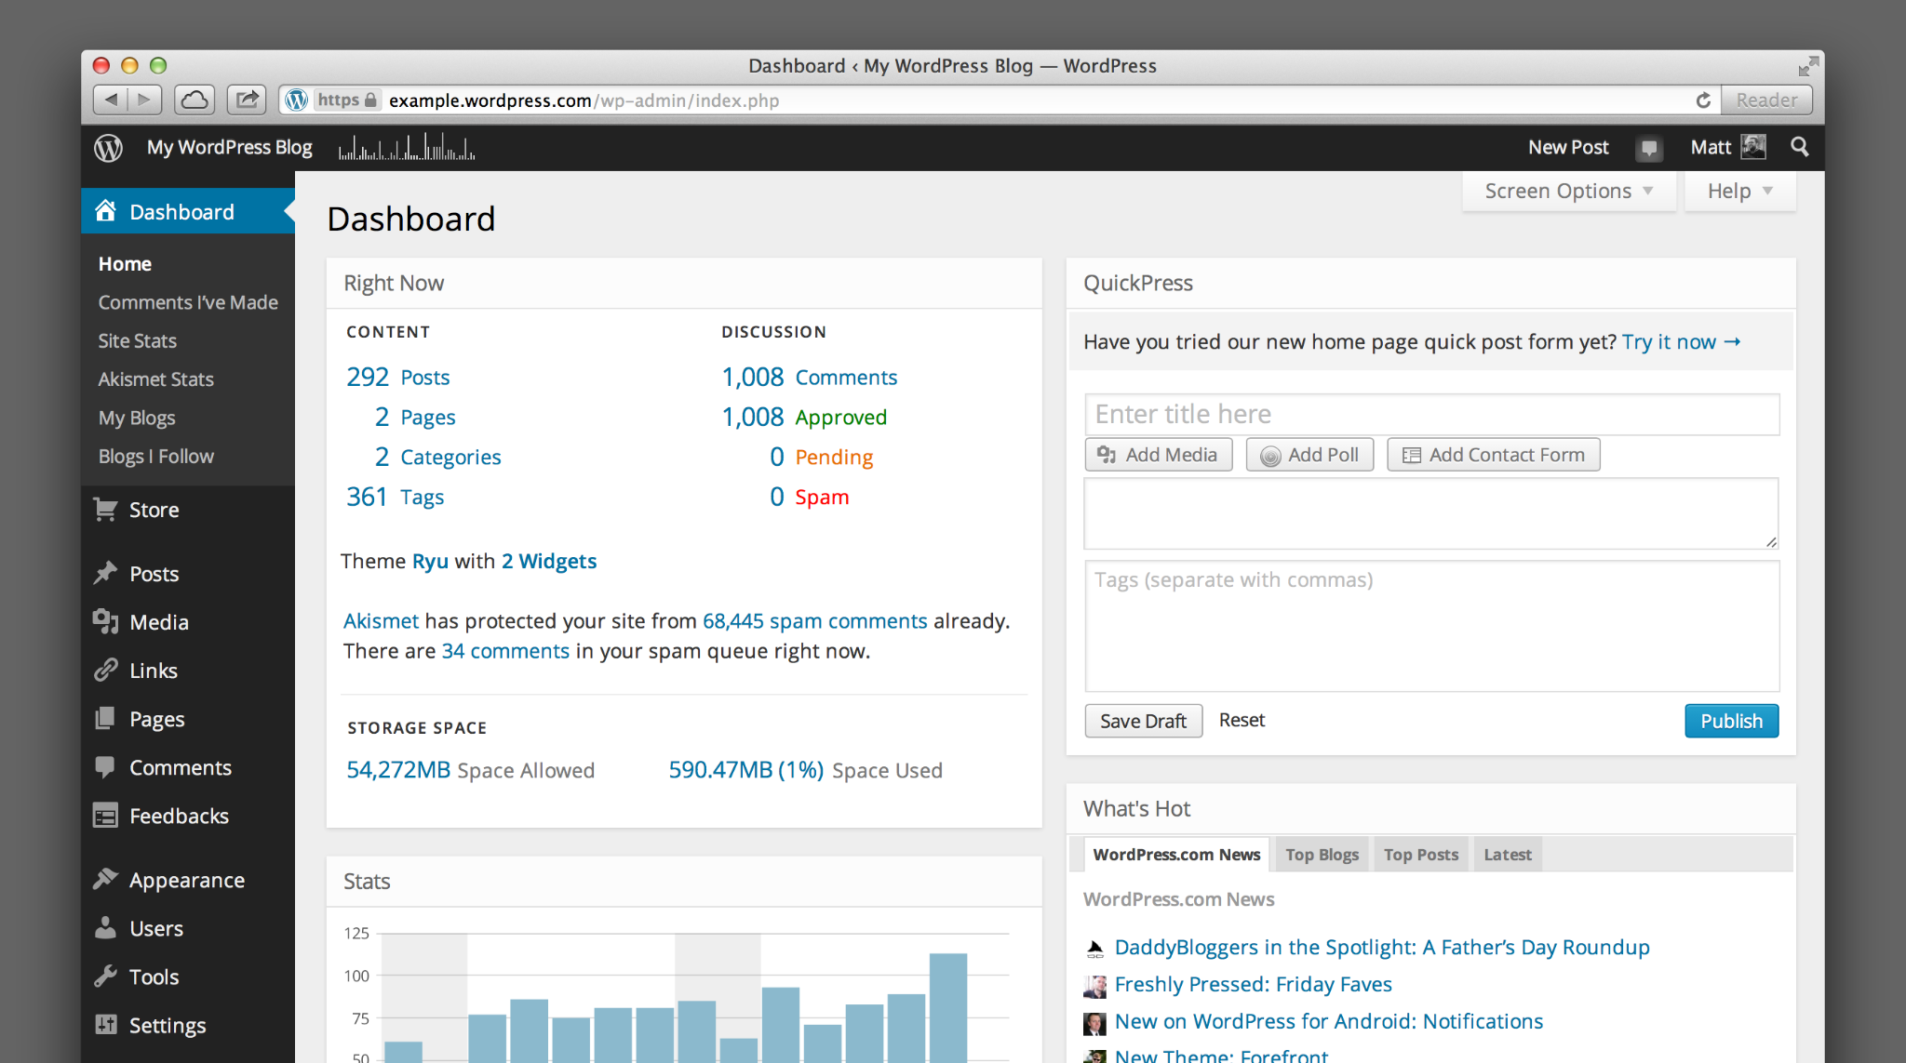
Guide to using wordpress
●There are a number of ways for you to create your dream website with WordPress. Users generally find the software easy to use, but getting started can be understandably intimidating if you’re completely new to the process.
How to Build a WordPress Website?
1.Select a WordPress plan (WordPress.com only).
2.Set up your domain name and hosting provider.
3.Install WordPress.
4.Choose your theme.
5.Add posts and pages to your website.
6.Customize your website.
7.Install plugins.
8.Optimize your website to increase page speed.

Slide 9
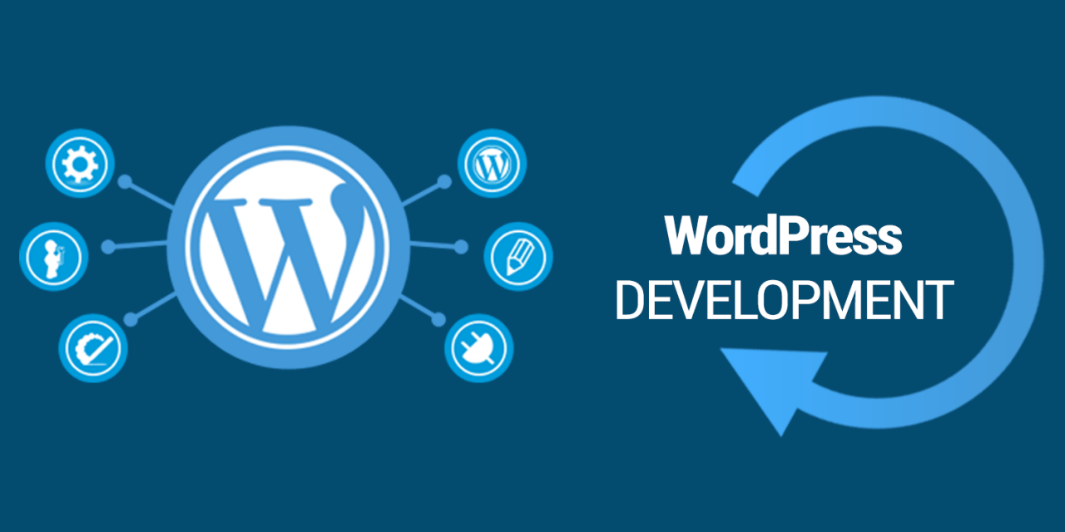
Advantages of WordPress
1. User-Friendly
2. Plugins
3. SEO-Friendly
4. Responsiveness
5. Open-Source Community

Slide 10
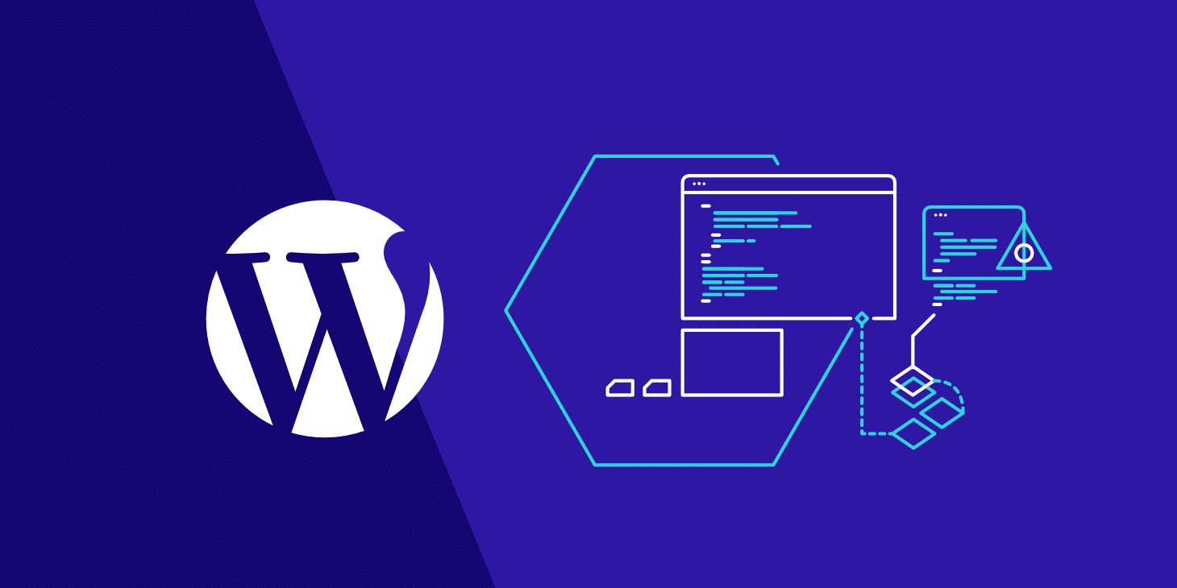
Disadvantages of WordPress
1. Customization
2. Data Security
3. Frequent Updates
4. Website Can Go Down Without Notice

Slide 11
Websites developed with Wordpress
●The thing is, when people think of WordPress, a lot of them still think it’s only good for small to medium-sized business websites or blogs.
●In fact, many people believe the popular CMS is not powerful enough to handle big-name corporations, well-established global brands, or even the personal websites of some of the world’s most famous celebrities.
●But It is capable and many of the website of world famous brands is developed using wordpress.
TechCrunch, BBC America, The Walt Disney Company, Vogue, Yelp, MTV news,TED Blog, Evernote, SnoopDogg, Katy perry, Usain Bolt.

Slide 12

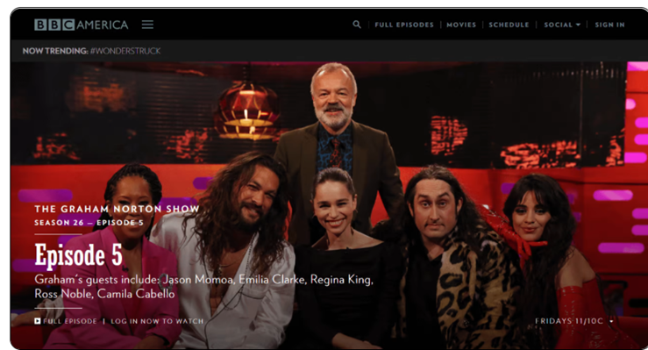

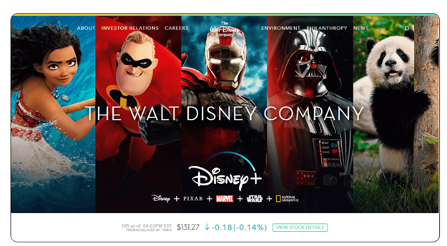

Slide 13
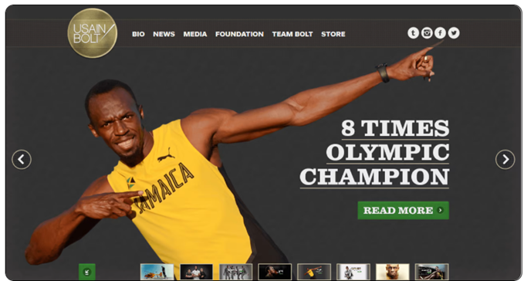
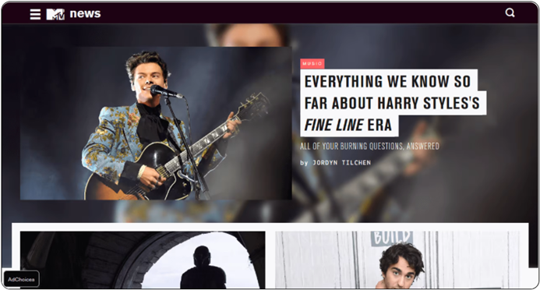

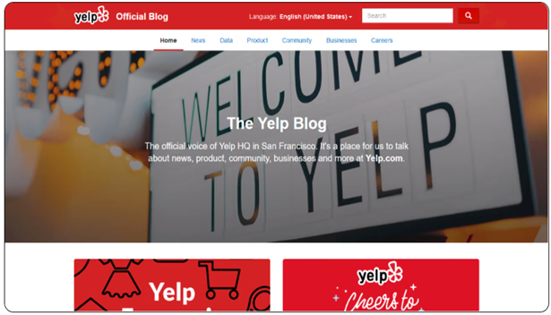

Slide 14
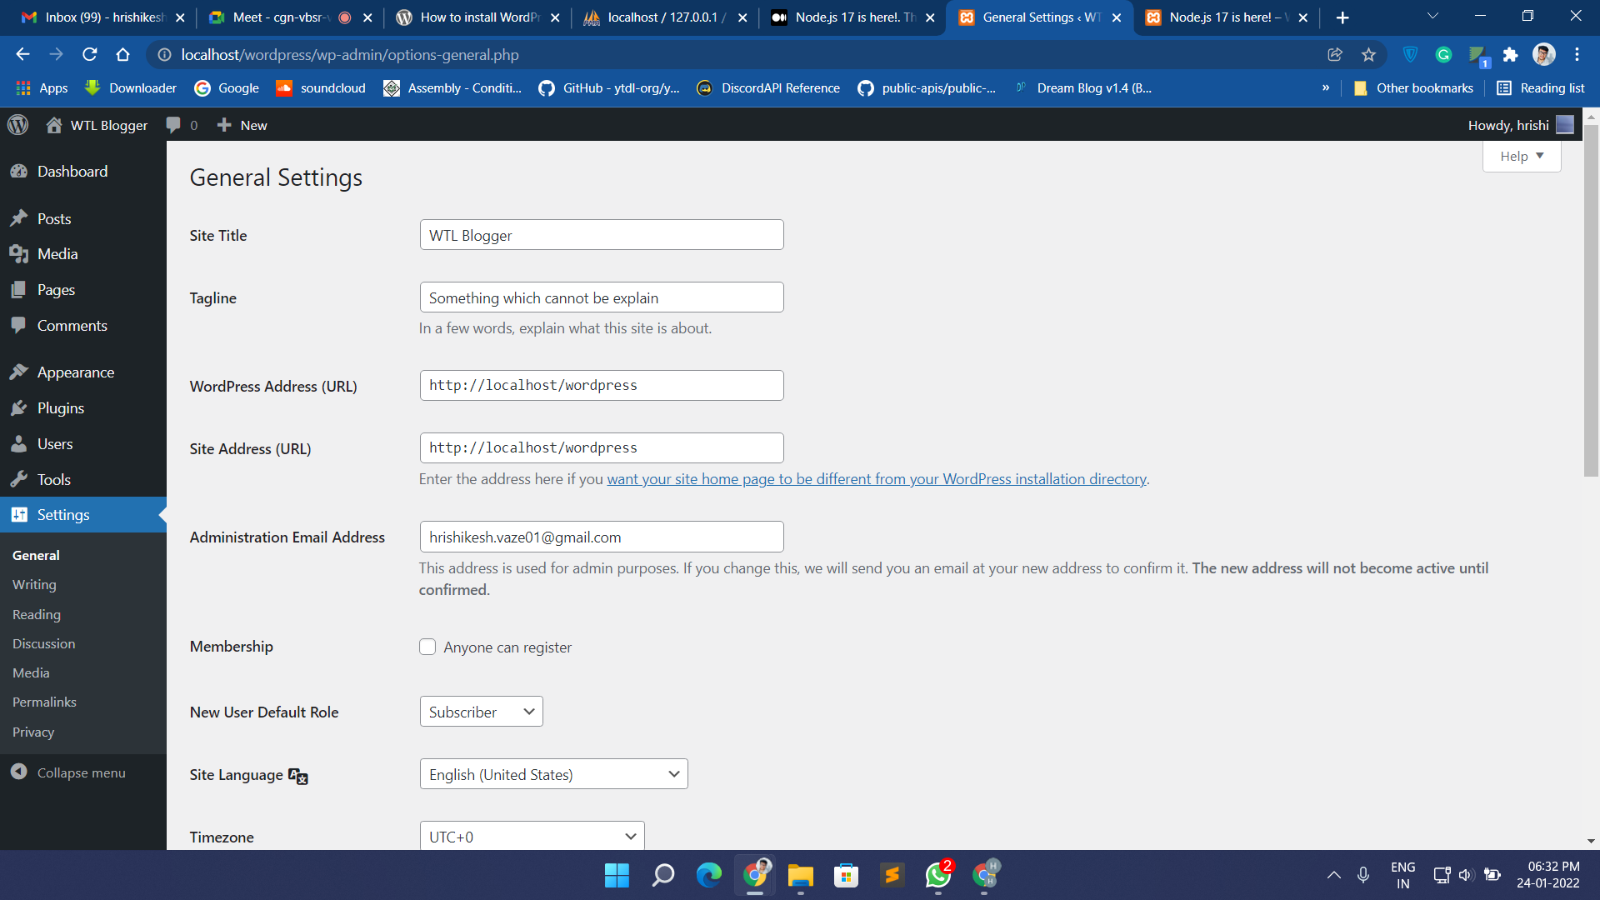
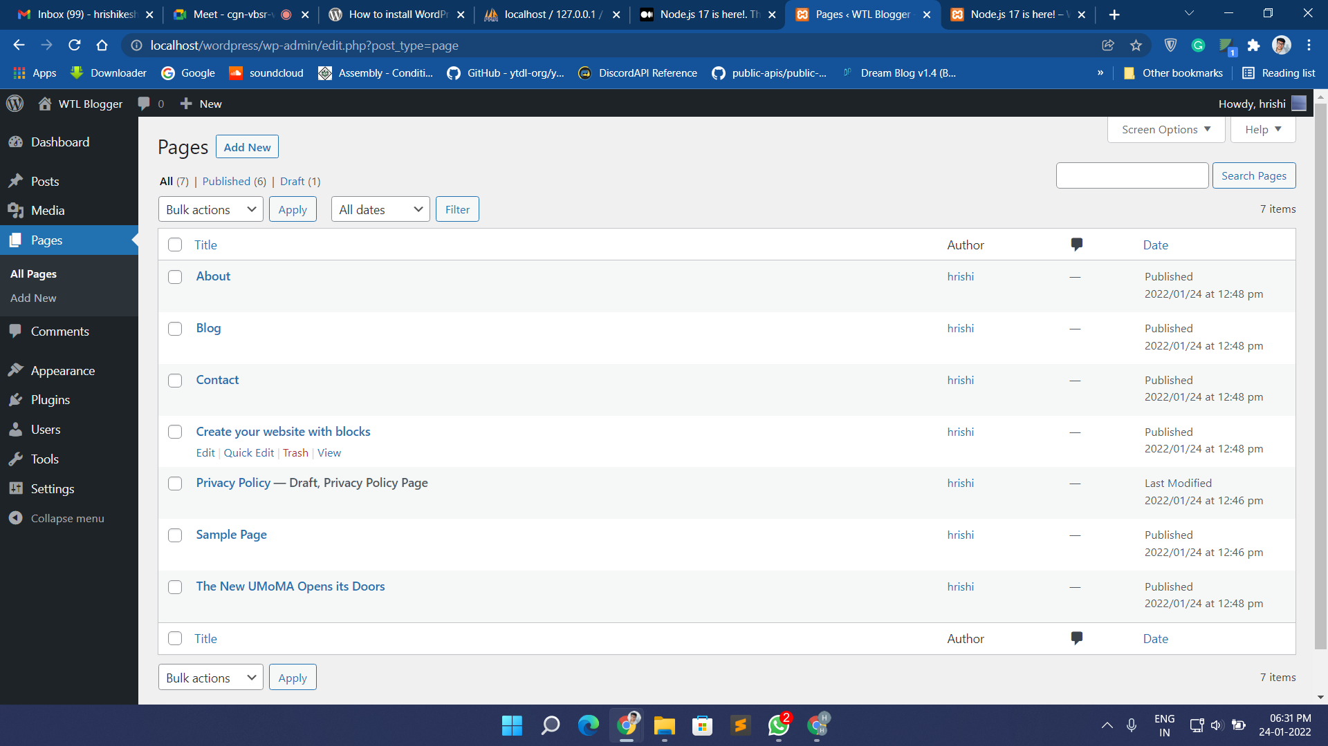
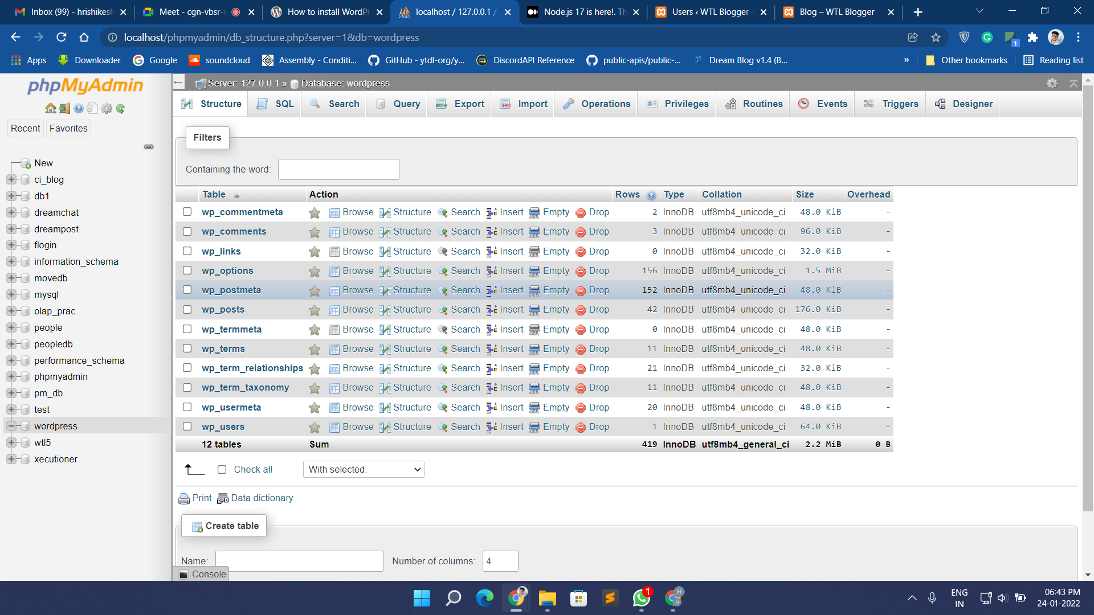
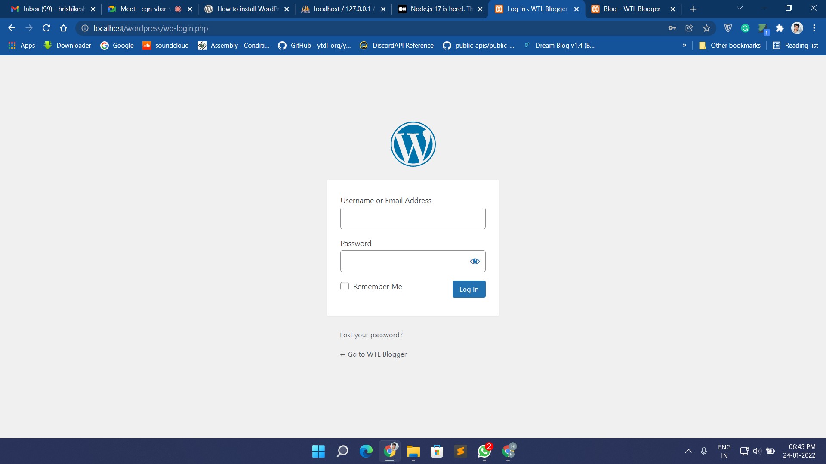

Slide 15
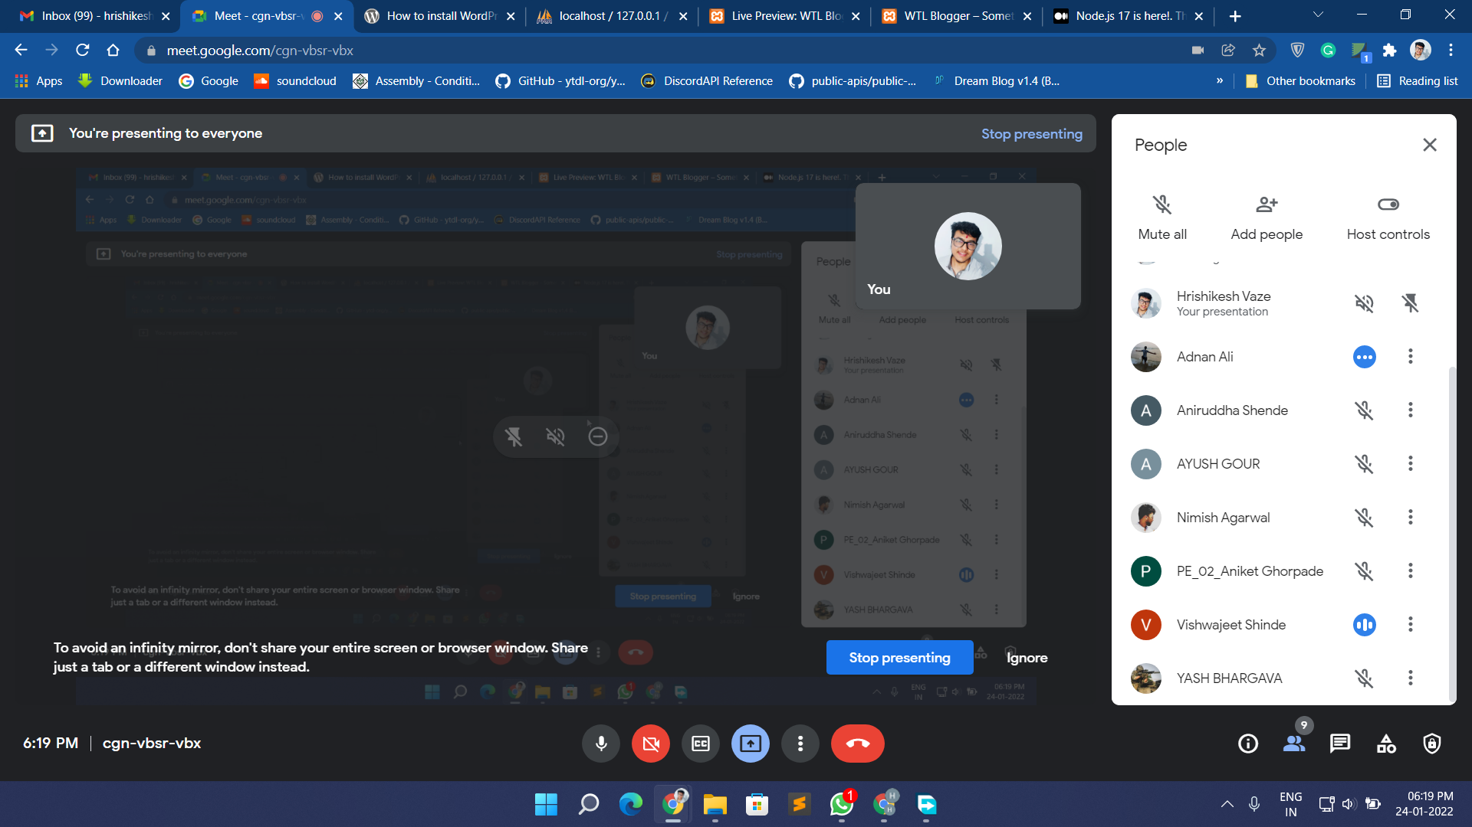
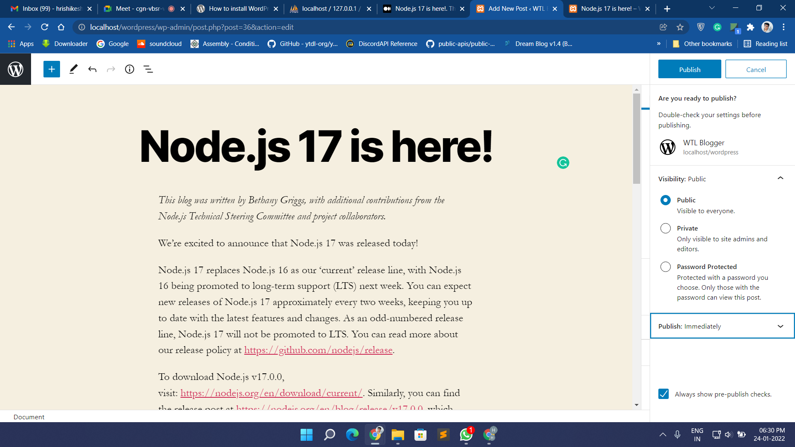
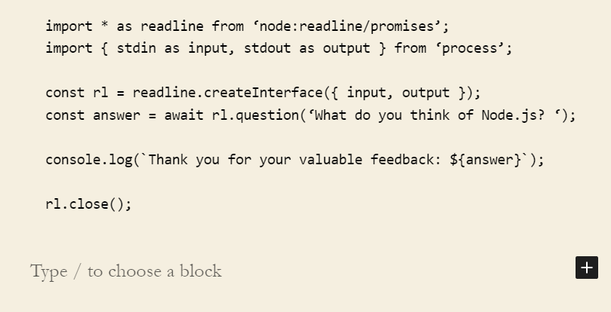
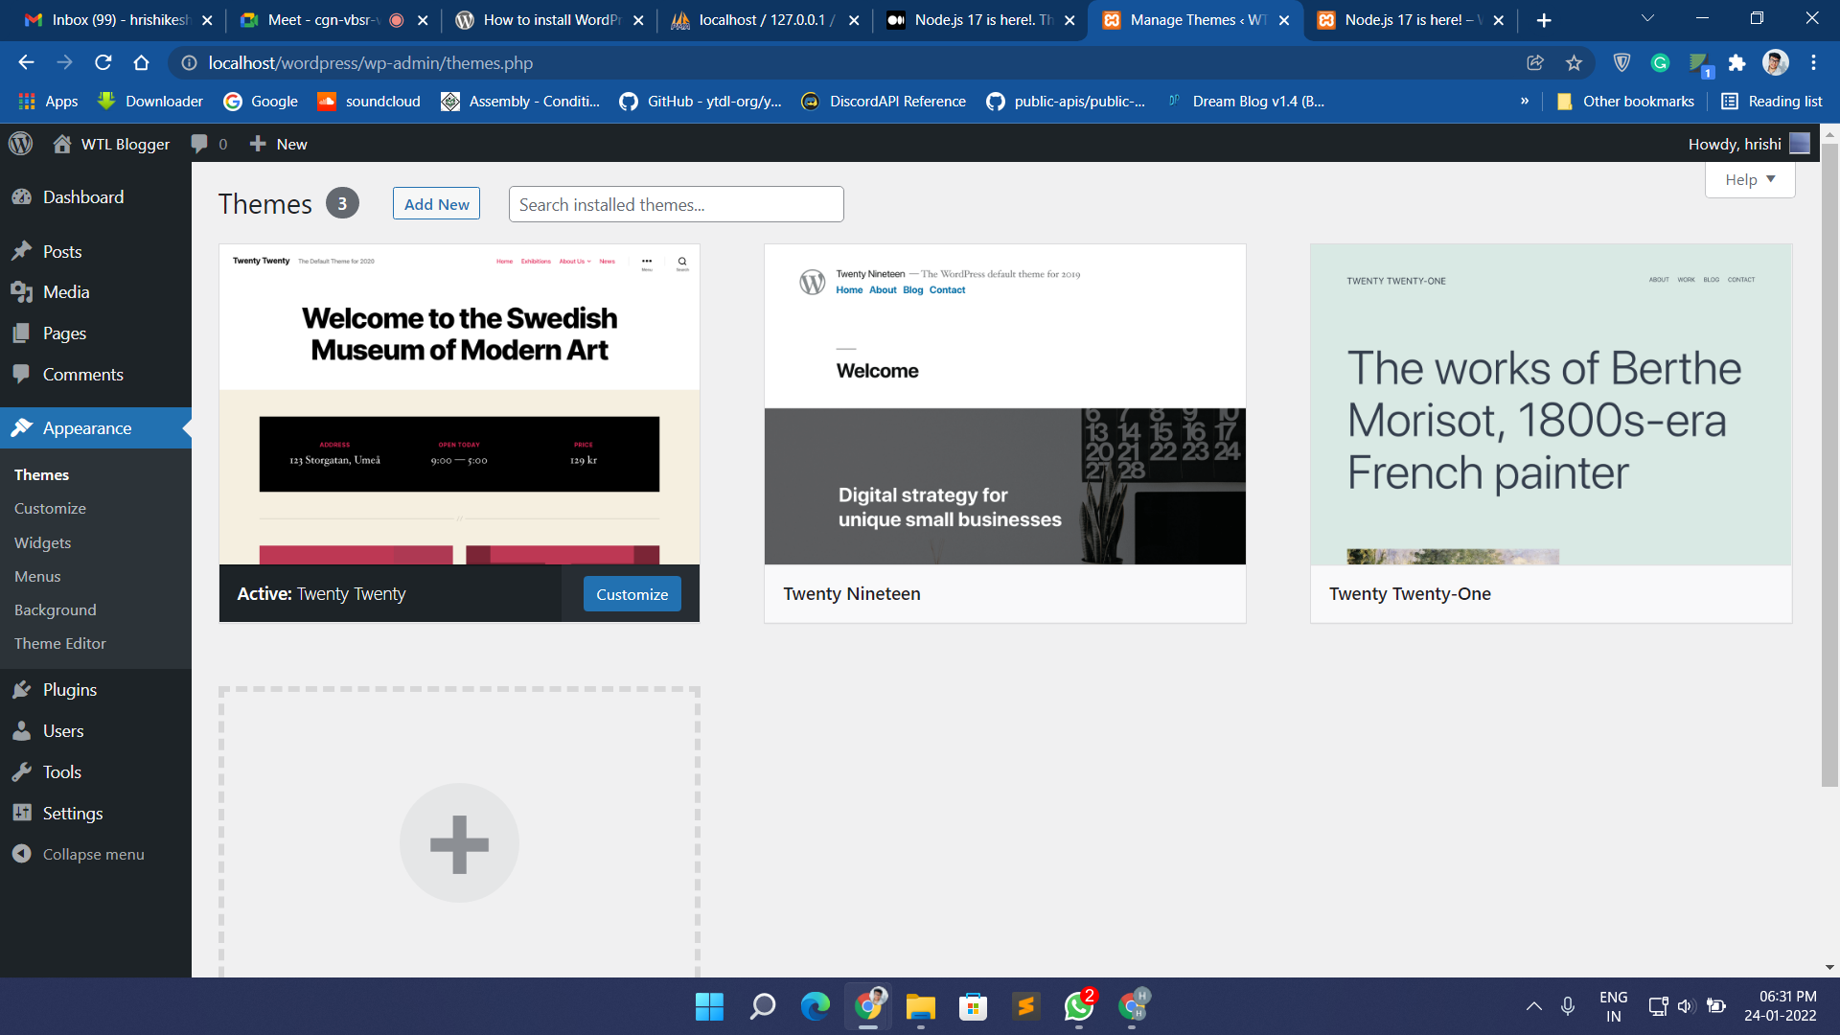
THANK YOU !

